Slide 1
Lab 5 Part III

Slide 2
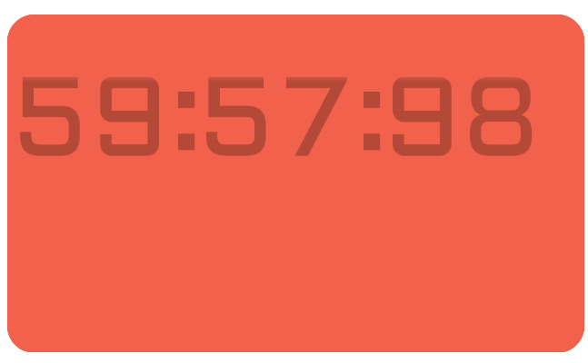

Slide 3
Lab 5 Part III
CLOCK_50
Reset_n
M1
M0
en_M0
S1
S0
en_S0
H1
H0
Slow clock
enable
en_M1
en_S1
en_H1
en_H0
roll_M0
roll_S1
roll_S0
roll_H1
roll_H0
roll_one_Hundredth
roll_M1

